Slide 1
HPE OneView and Nagios Integration
Aug 2018
GSE Team

Slide 2
Agenda
Problem statement
Solution Overview
End outcome
Demo

Slide 3
Problem Statement
Some of our Synergy customers were looking for hardware monitoring solution through OneView and Nagios.
Today, customers are using Nagios to monitor their compute infrastructure using OS based agents and SNMP traps.
Customers don't have a solution to monitor
Server hardware health ( through oneview )
enclosure status
interconnects status
ports status
power consumption and
ports statistics and utilization data.
This gap was delaying their ability to resolve the outages and infrastructure failures.

Slide 4
Solution Overview
Developed a plugin using Python which collects health status and utilization statistics for physical infrastructure including servers and shared resources like enclosures and virtual connects.
Plugin does necessary processing of collected data before posting to Nagios.
For utilization statistics, plugins does polling of OneView using REST API because OneView metrics API ( MSMB ) is not providing the utilization for ports level.
The plugin has intelligence to determine whether to create new entry or update an existing entry in Nagios.
Plugin is designed to handle processing of alerts data in parallel by running concurrent threads.
There will be one plugin instance required for each OneView appliance.

Slide 5
Integration Architecture

Slide 6
End outcome
Once the data is posted to Nagios, user can view health status and utilization data in Nagios UI.
If there are more than one OneView posting data to Nagios, data is grouped under respective OneView group within Nagios.
The solution we developed is more generic monitoring solution and doesn't limit to any particular customer.
The plugin can be deployed on any Linux based server or a docker container.

Slide 7
Nagios – OneView service mapping
Nagios
Host Groups
Eg: Linux_Host_Group, Windows_Host_Group etc
Hosts
Eg: DNS_Server, DHCP_Server, App_Server etc
Services
DHCP, DNS, FTP, TELNET, PING etc
Nagios Service status
0, 1, 2, 3
OneView
OneView Appliance Group
OneView_10.188.239.16, OneView_192.168.122.21 etc
Servers, Enclosures & Interconnects
DL380G9_122, ILOMXQ122411RG etc
OneView Alerts
Storage_611, Memory_098, None_233, Logs_66, Power_21
OneView alert severity
Ok, Warning, Critical, Unknown

Slide 8
Design considerations
One plugin ( Docker container ) per OneView appliance
Alerts are pushed into Nagios ( passive check ) vs Nagios pulling alerts ( active check )
To support the multiple OneView into single Nagios server
Alerts are grouped by OneView appliance
Wherever possible, alert ids are used to avoid the duplicate entry
Posting alert into Nagios
Update if service (entity) is already present
Else create it
If alert is cleared in OV – send update to nagios
Supports filtering/control of alerts and resources
Can send only critical alerts
Can send only server hardware alerts
Modular design
Inputs are configurable and controlled through config file
Support for logging
Note: Creating ticket based on the alert received in Nagios is out of scope for now

Slide 9
Demo

Slide 10
Thank You
GSE Team

Slide 11
Backup slides

Slide 12
Use Cases
Ability to report HPE Server Hardware alerts into Nagios
Ability to report shared infrastructure health status into Nagios
Enclosures alerts ( health status )
Power supplies status
Fan status
Statistics like power consumption
Interconnects status
Ability to report interconnects port status into Nagios
Interface name
Speed
Throughput
Mac address
Linked/unlinked

Slide 13
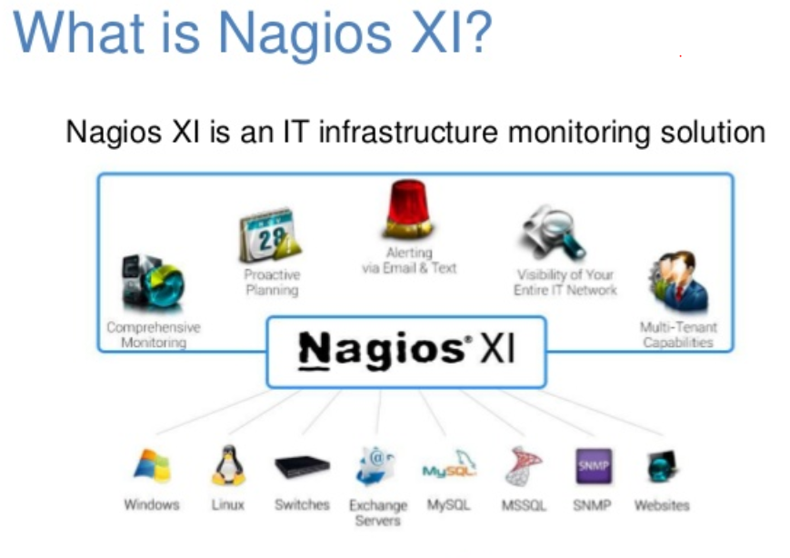
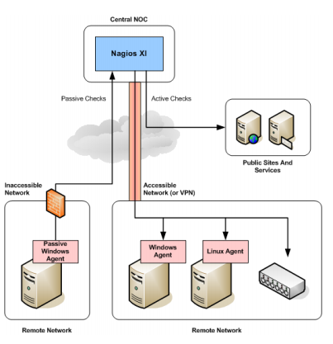
High level architecture of Nagios

Slide 14


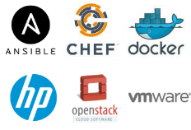
















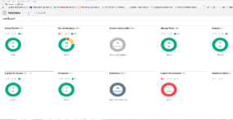

HPE Software-defined Infrastructure backed by the Industry’s broadest Partner Ecosystem
DevOps engine
IT Ops engine
Cloud engine
Facilities
engine
Unified API
Developer toolkits
Compute
Storage
Network
Powered by HPE OneView
www.hpe.com/info/composableprogram
Notes:
Introducing HPE OneView 3.0 - Your infrastructure automation engine
Deploy infrastructure faster
Enables faster compute automation through server profile templates that rapidly provision physical, virtual, and containerized systems
Changes can be specified in the server profile template and then rolled out to multiple systems simultaneously
OneView automation provisions storage volumes, zones the fiber channel SAN and attaches 3PAR StoreServ storage to the server profile
Simplify IT Ops by automating >50 lifecycle tasks
Single interface, you can rapidly design, provision, monitor and update your IT resources.
Managing up to 6,400 nodes today and more in the future wit Global dashboard
Keeps your infrastructure running at peak performance with minimal workload disruption
Increase productivity with a unified API and partner ecosystem
Unified API increases productivity – Lets developers and ISVs automate infrastructure deployment and updates without detailed knowledge
A growing list of ISV partners are taking advantage of the unified API
Additional partners - SaltStack, SUSE, Eaton and nLyte, making the partner, dev op, cloud and facility management tools more agile and efficient.
You no longer have to spend valuable staff time on writing, debugging, and updating custom scripts.
Built-in integrations with key HPE analytic management tools

Slide 15
Demo
Show live Demo
Walk through
Show oneview
Show nagios ( with clean setup )
Show the plugin inputs
Start the plugin
Show the trap simulator tool
Show alert in OV activity
Show the log
Show the alert showing up in Nagios
Show the port statistics
Repeat the steps for various flags like severity..etc

